Slide 1
FUNDAMENDALS OF DATA LITERACY WITH TABLEAU
Project title :
Analyzing Housing Prices In Metropolitan Areas Of India
Team ID:
NM2023TMDID09478
Team Lead ID:
612D6B75E8158D6B9F94E936C6A08D2F
Team Member’s ID:
448A4CE4D9E6846969A463E6AE3AD032
612D6B75E8158D6B9F94E936C6A08D2F
6FEFEDC11C50FFB894B4A3DCAA7495FC
EE020687E58B18AAF9246A3367BABE6C

Slide 2
PROJECT REPORT
1. Introduction
House price prediction in a metropolitan city in India is a valuable solution for potential home buyers, real estate agents, and investors. By leveraging historical sales data, property details, and location-specific information, a predictive model can accurately estimate house prices. The model's scalability, real-time updates, user-friendly interface, and transparency ensure it meets the needs of stakeholders. Integration capability, data privacy, and cost-effectiveness are also important considerations. By addressing these requirements, the prediction model provides reliable insights, empowering stakeholders to make informed decisions in the fast-paced real estate market.

Slide 3
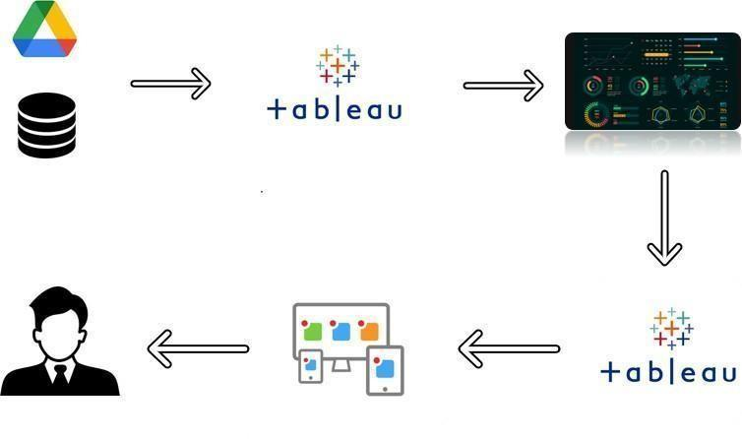
TECHNICAL ARCHITECHTURE:
PURPOSE:
This project helps us to analyze the data .
It make us to be skilled in future for our job carriers .

Slide 4
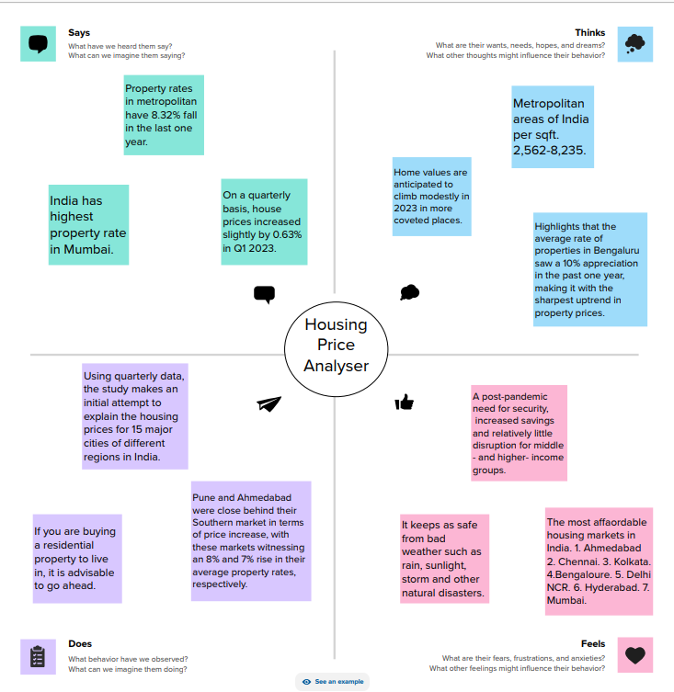
2.Problem definition and design thinking: empathy map:
.

Slide 5
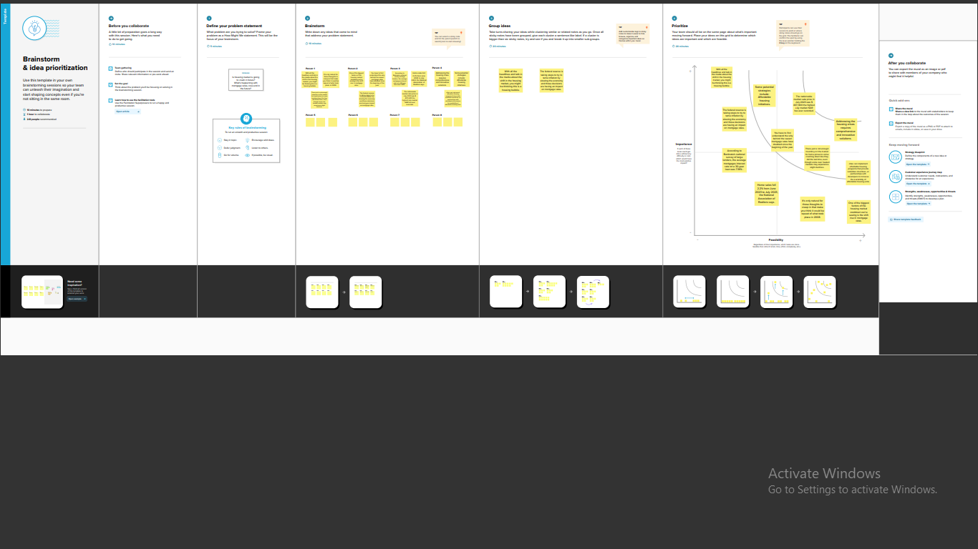
Brain storming map:

Slide 6
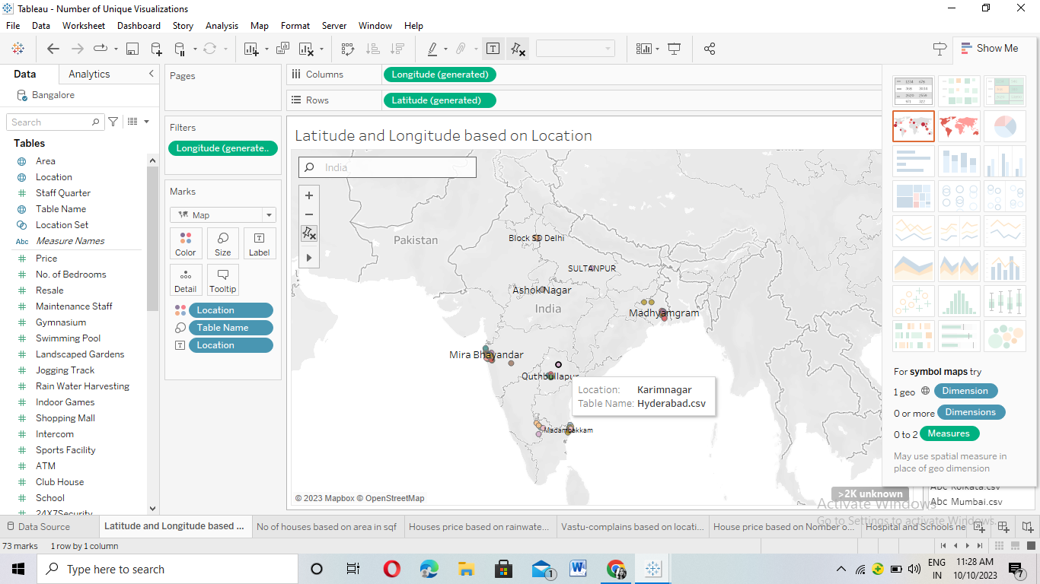
3.Result:
Data visualization:

Slide 7
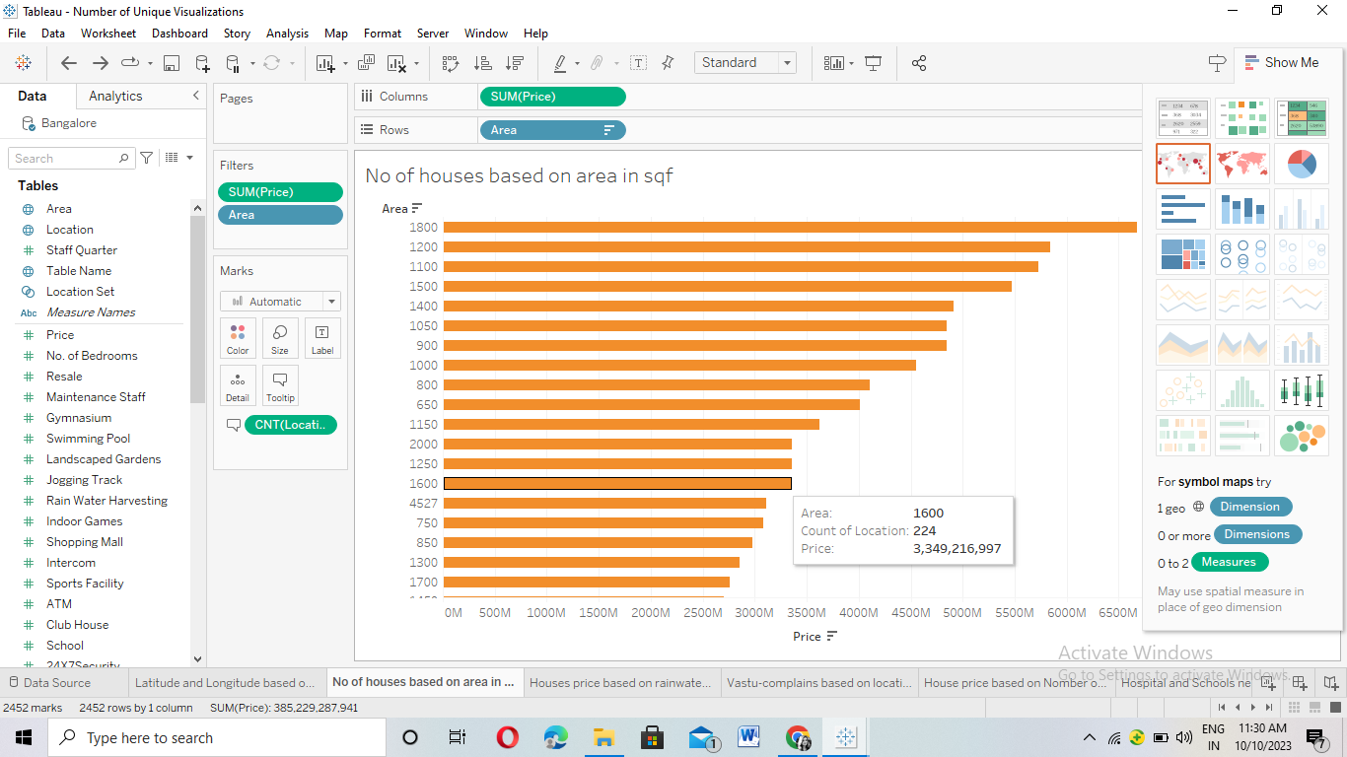

Slide 8
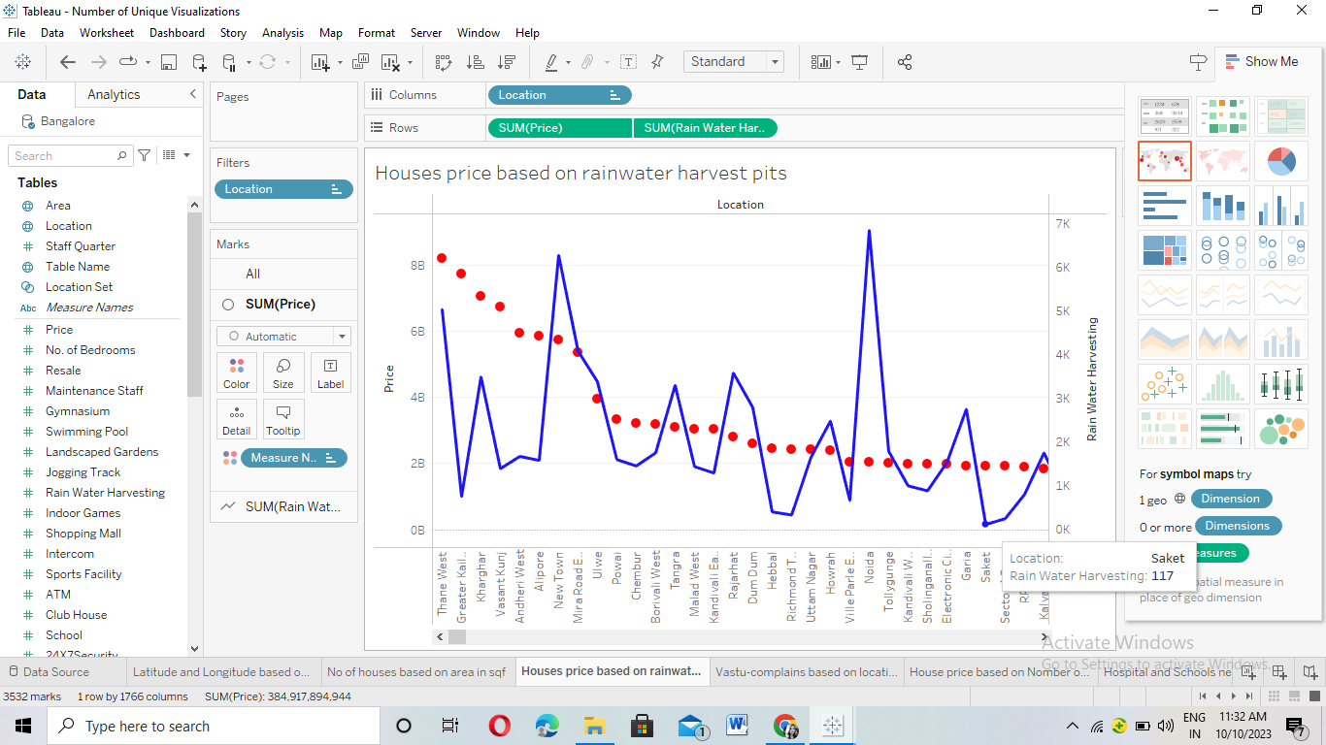

Slide 9
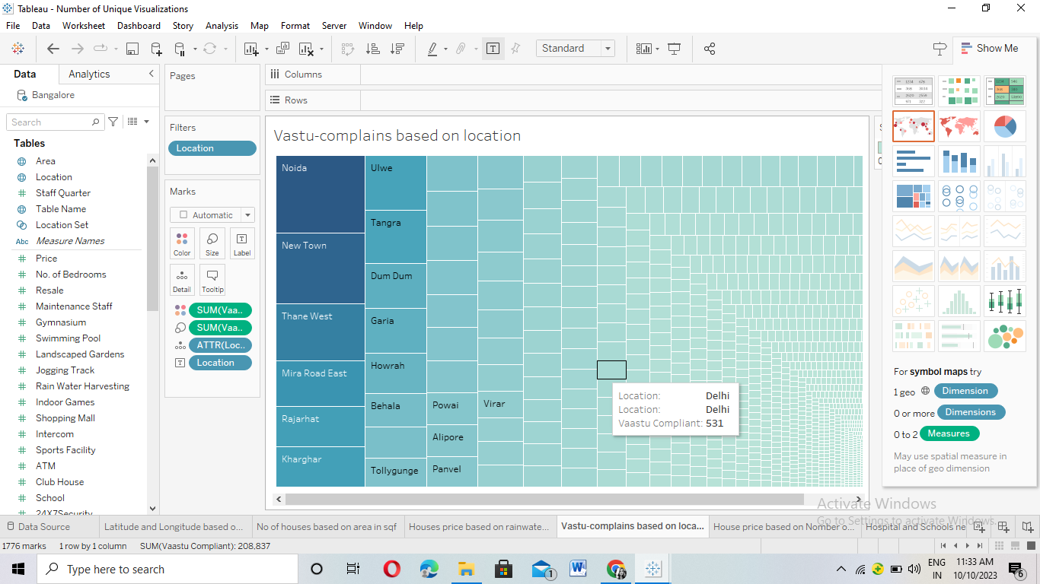

Slide 10
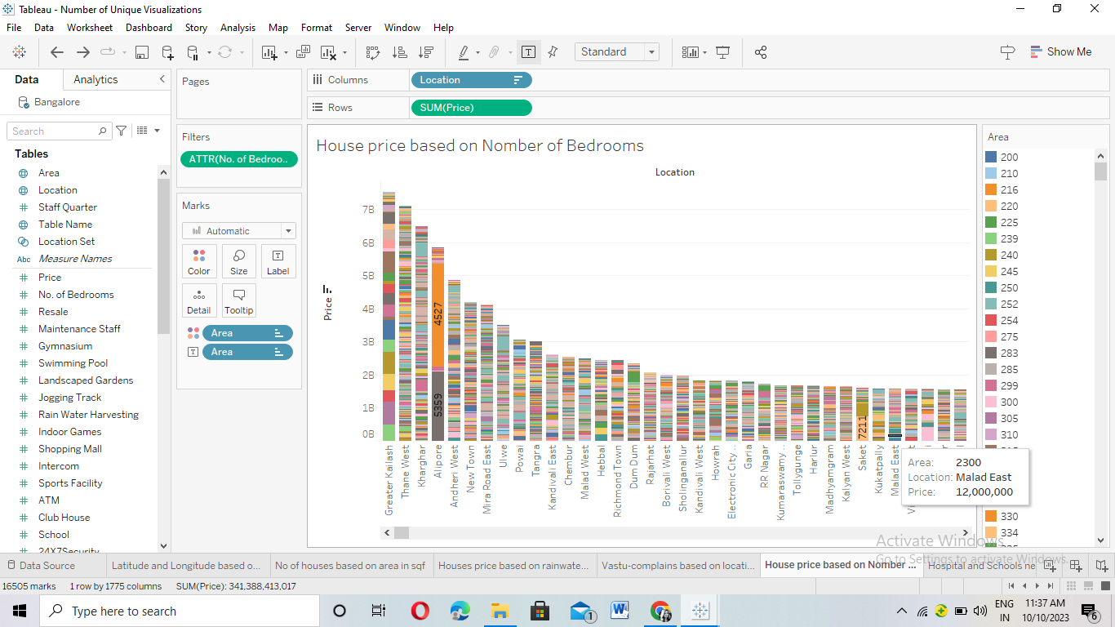

Slide 11
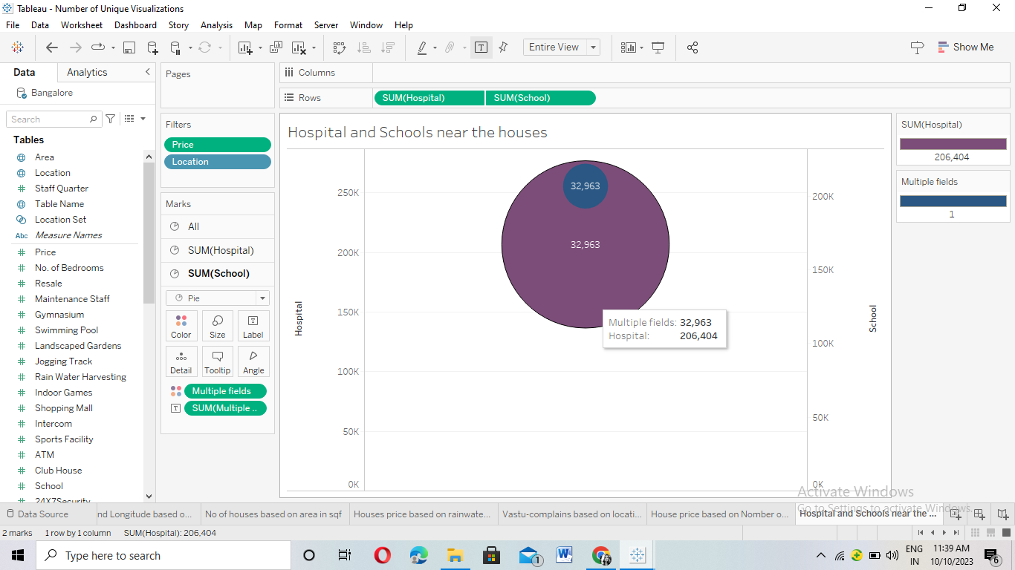

Slide 12
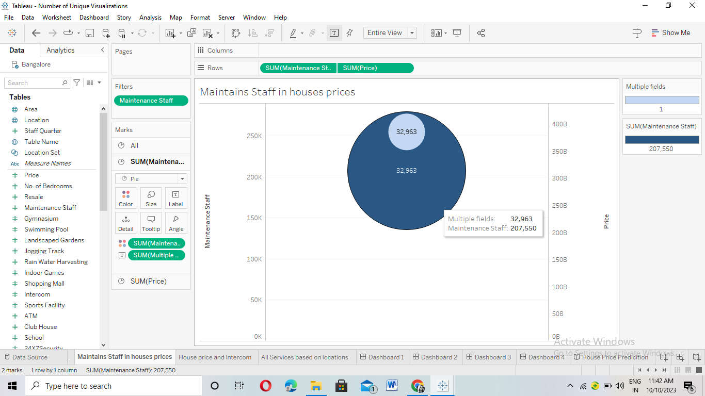

Slide 13
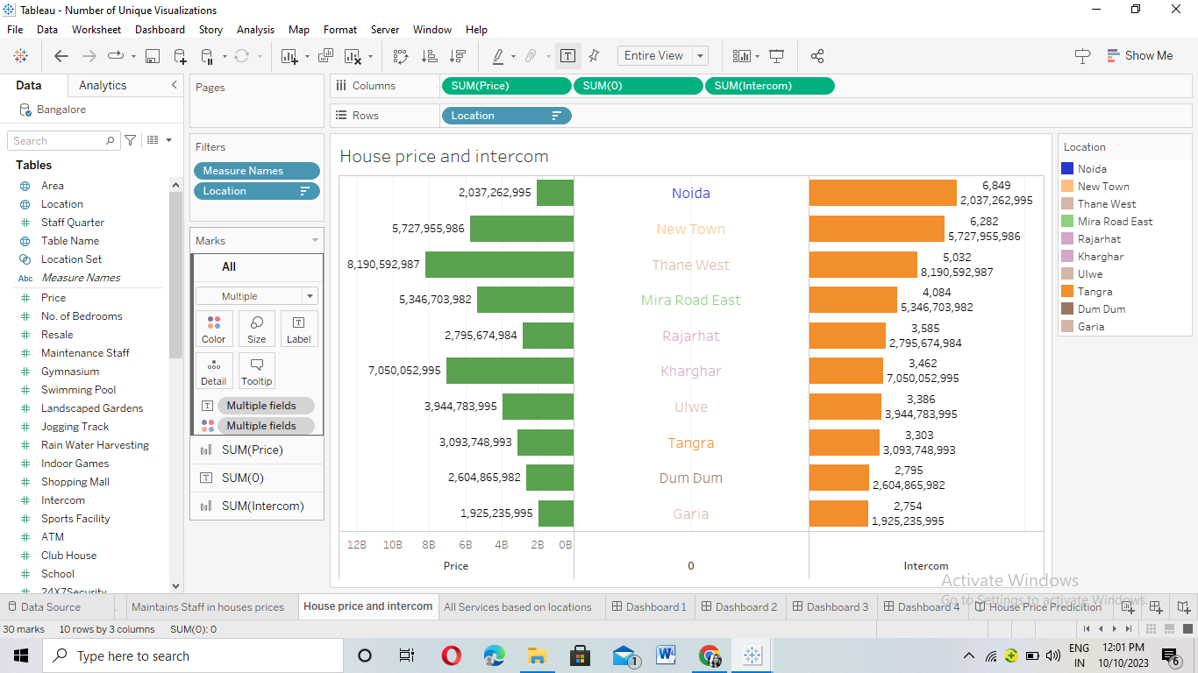

Slide 14
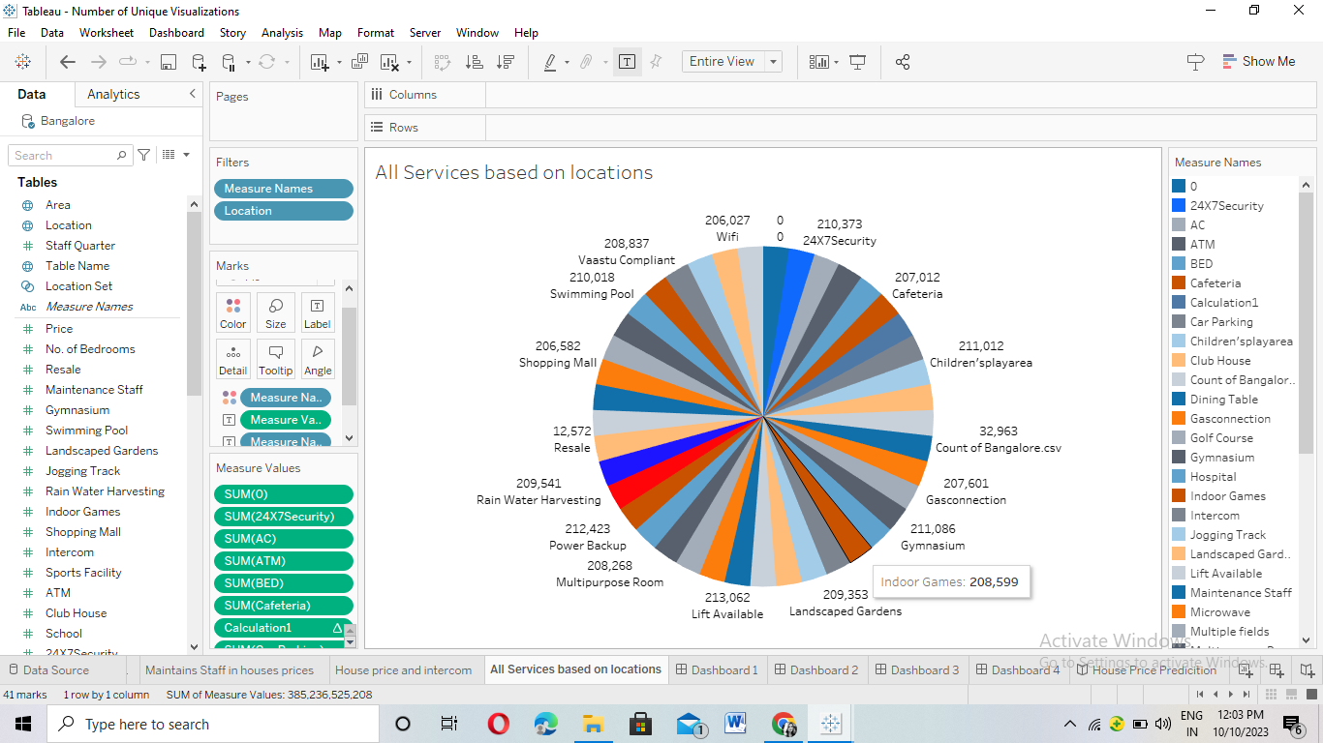

Slide 15
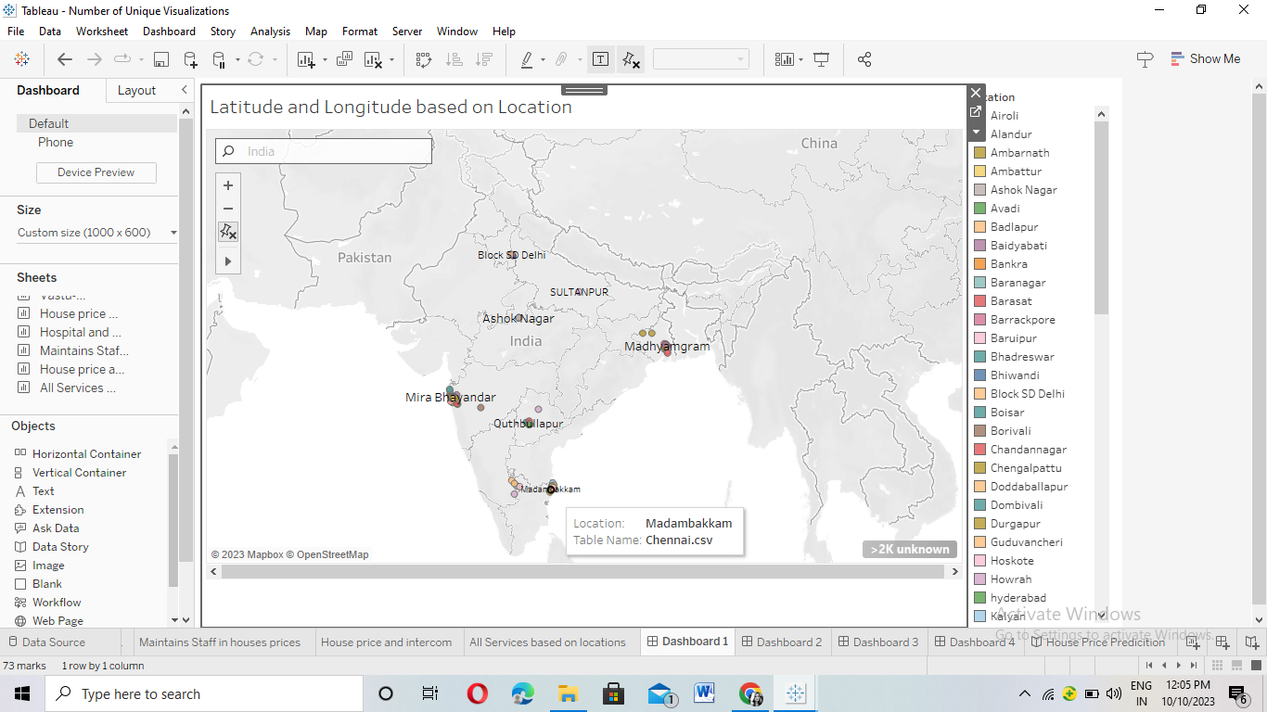
Dashboards:

Slide 16
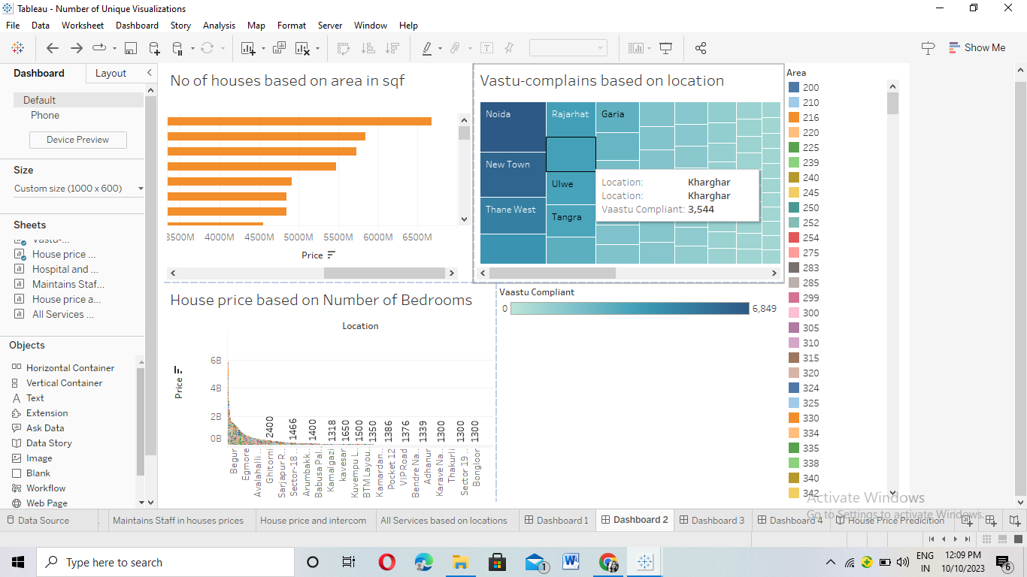

Slide 17
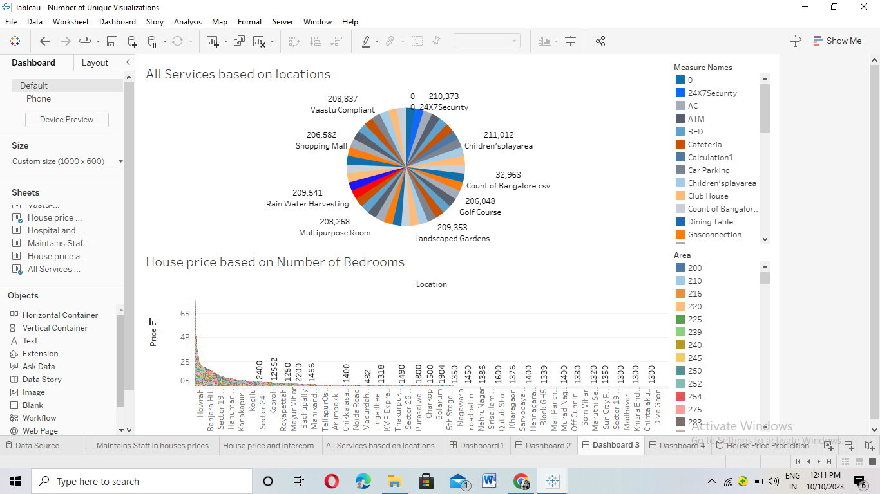

Slide 18
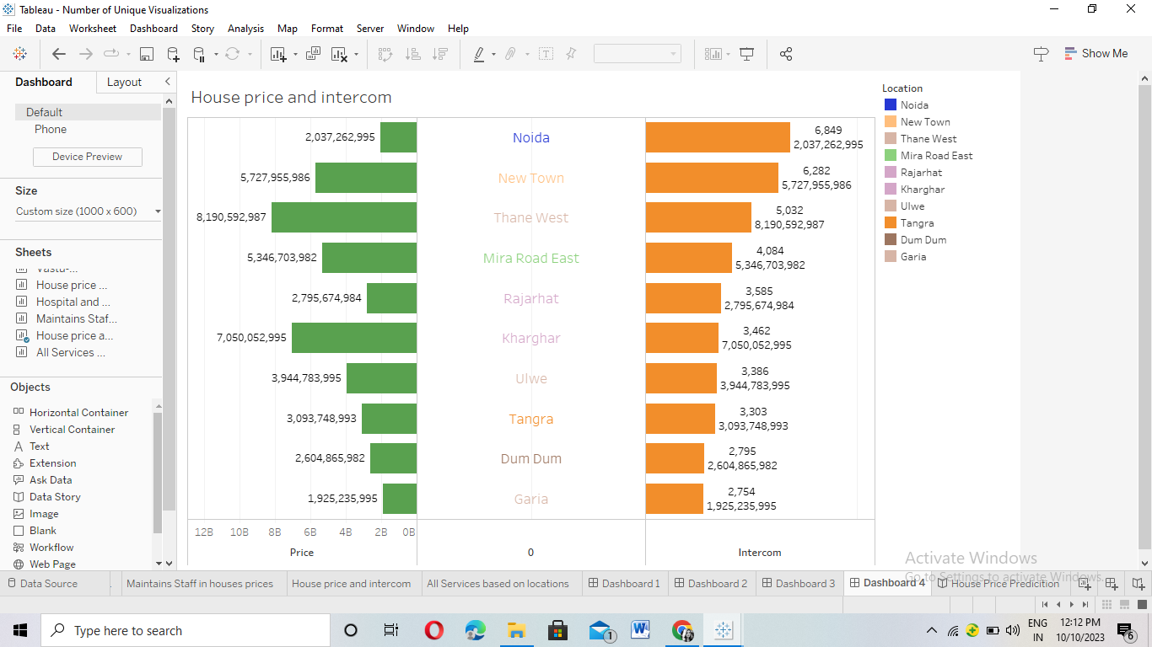

Slide 19
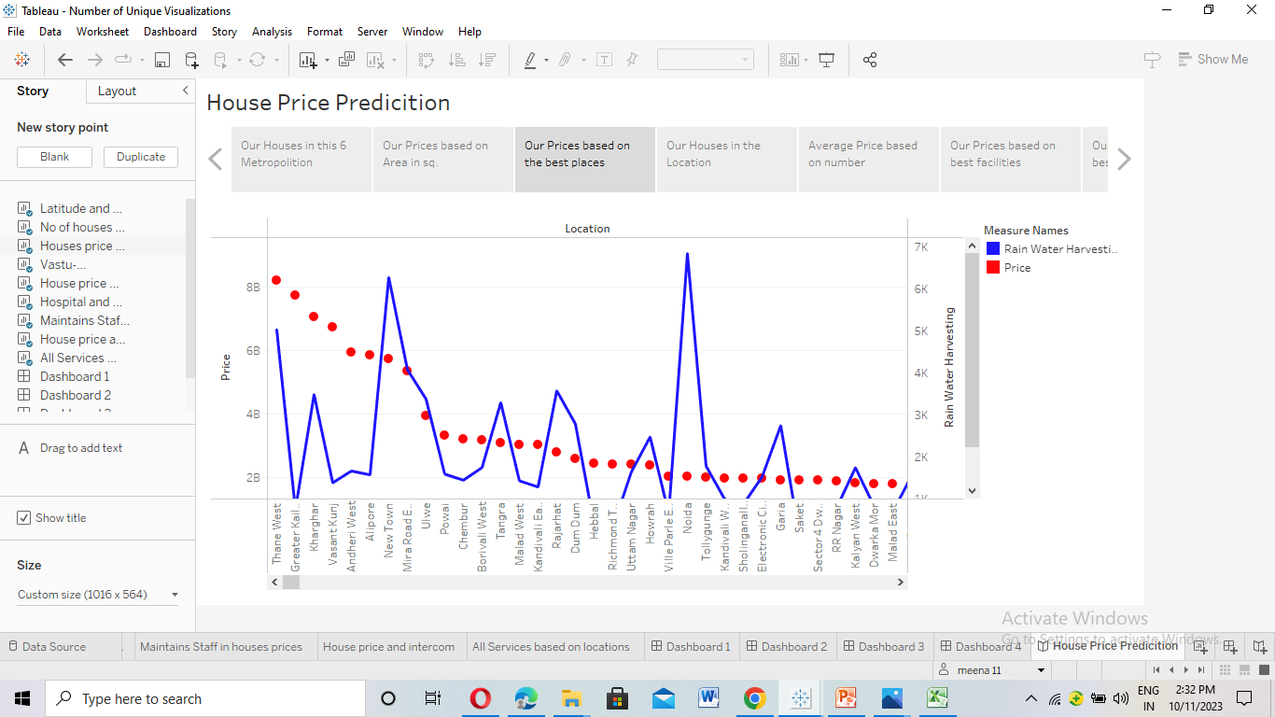
Story:

Slide 20
4. Advantages and Disadvantages
Millions of rows of data can be handle with efficiency via Tableau.
Building dashboards with Tableau allows even non-technical users to create interactive, real-time visualizations in minutes.
Time duration of Tableau is very short (14 days).
No predictive analytical capabilities Tableau Software allows users only to analyze what has happened.

Slide 21
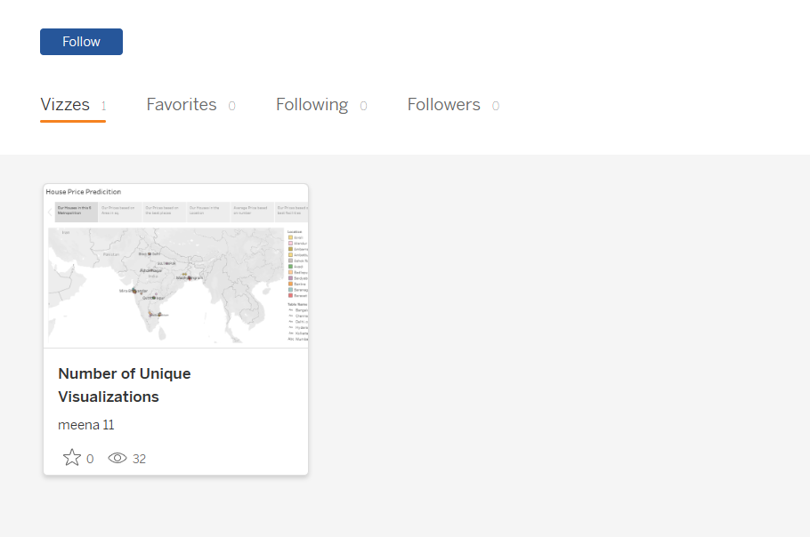
5. Conclusion:
Though the dataset is complex or the dataset is very big, in tableau, we can create dashboards very easily and within less time.

Slide 22
6. Future Scope:
Tableau is a good to have knowledge, but building a career out of tableau is never advisable. Tools keep on changing as technology updates.
So learning tableau is good, it is a steeping stone of your career. Don’t try to build an entire career based on that.

